Slide 1
Prediction of Human Activity Using Machine Learning
Final Thesis Presentation
Benjir Islam Alvee, Sadia Nasrin Tisha
[Student ID: 16101112, 16101101]
Department of Computer Science & Engineering
BRAC University
Supervisor:
Dr. Amitabha Chakrabarty
Associate Professor
Department of Computer Science & Engineering
BRAC University

Slide 2
Outline:
Introduction
Background, Motivation, Problem Statement, Thesis Statement
Related Works
Dataset
Existing Dataset: Dataset description, Data preprocessing, Dimension reduction techniques, Data visualization
New Dataset: Device Description, Dataset description, Data visualization
Methodology
Machine Learning: SVM, Linear Regression, KNN, Random Forest Classifier, Logistic regression ,Naïve Bayes, Decision Tree
Neural Network: MLP, LSTM
Result Analysis
Limitations
Conclusion & Future works
References
Response to the comments on thesis report

Slide 3
Introduction:
Background Study:
2006
2008
2012
2015
2017
First experiment of human activity data using gsm and accelerometer sensor on computer.
Beginning of data collection and processing using smartphones
Concentration on detecting complex behavior
Application of deep learning
Reducing classification errors through comparison between different models

Slide 4
Introduction(Cont.):
2. Motivation:
Data collection through smartphone
Smartphone being a portable device is easy to operate
Embedded sensors e.g. accelerometer & gyroscope
Targeted activities: laying, sitting, standing, walking, walking downstairs and walking upstairs

Slide 5
Introduction(Cont.):
3. Problem Statement:
Calculations’ complexity and results’ accuracy depends on the type of dataset
Analyzing large number of features is challenging
Application of reduction techniques improves the accuracy

Slide 6
Introduction(Cont.):
4. Thesis Statement:
Observing daily activities of human using waist mounted device
Collecting data of new dataset
Modeling data and analyzing results using classifiers
Application of dimension reduction techniques to existing dataset
Modeling data of existing dataset and obtaining accuracy
Detecting the best fit algorithm for both dataset

Slide 7
Related Works:
A Public Domain Dataset for Human Activity Recognition Using Smartphones:
Introduced a new publicly data set For Human Activity Recognition using smartphone sensor( accelerometer & gyroscope)
Activities: Walking, Sitting, Standing, Laying down, Walking upstairs, Walking downstairs
Classifier: Acknowledged 96% accuracy using multiclass Support vector Machine
Recognition of Human Activities using Machine Learning Methods with Wearable Sensors
tried to recognize body activities from the perspective of sparse representation and random projections
Collected numerical data for five different activities using wearable sensors
Activities: Sitting, Sitting down, Standing, Standing up, walking
Classifier: SVM: 92%-99%, HMM: 90%-99%, ANN: 93%-99%

Slide 8
Related Works(Cont.):
Activity Recognition from Accelerometer Data
Analyzed activities using a single tri axial accelerometer and used meta classifier for better accuracy also study the effect of ontology of activities in terms of classifying activities which are hard to recognize
Activities: Standing, Walking, Running, Climbing up stairs, Climbing down stairs, Sit-ups, Vacuuming, Brushing teeth
Classifier: Decision Trees ,K-nearest neighbors, SVM, Naive Bayes
Human Activities Recognition in Android Smartphone Using Support Vector Machine
Developed a complete system included data acquisition system, features extraction, data processing, training and human activity recognition
Activities: Sitting, Standing, Walking, Upstairs, Downstairs, Lying
Classifier: Acknowledged 89.59% accuracy using Support vector Machine(SVM)

Slide 9
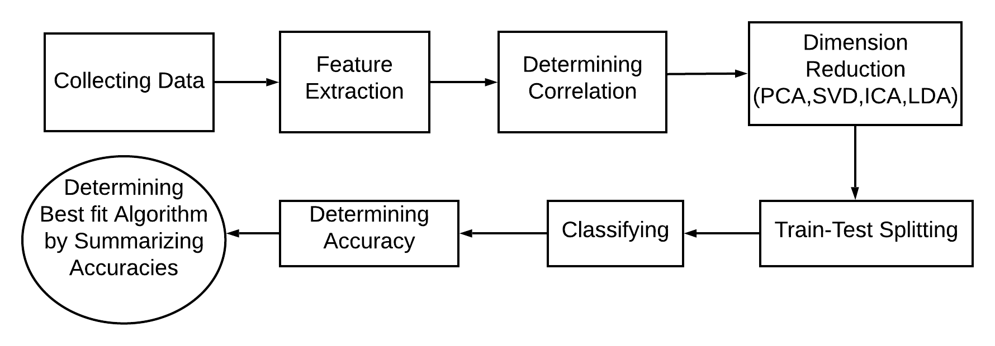
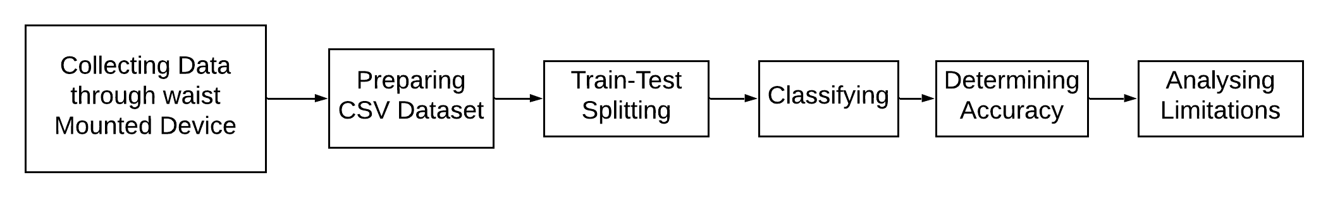
Workflow :
Figure 1 : Workﬂow of existing dataset
Figure 2 : Workﬂow of new dataset

Slide 10
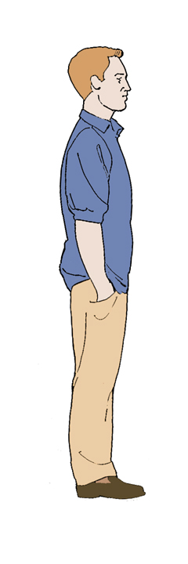
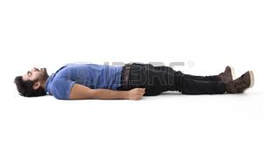


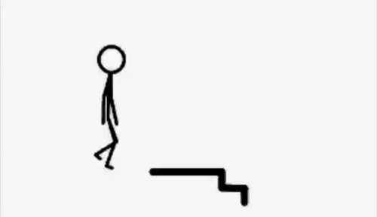

Dataset

Slide 11
Existing Dataset:
I) Dataset Description
Gathered accelerometer and gyroscope sensors through a waist mounted device
Observed standing, sitting, lying (static activities) , walking, walking downstairs , walking upstairs (dynamic activities)
Collected data of 30 people aged between 19 to 48 in a rich sensor responsive environment
This dataset has 7353 rows and 563 columns; 561 features
Estimated time for each person was 192 seconds
15 seconds for static activities and 12 seconds for dynamic activities
Interval between each activity was 5 seconds

Slide 12
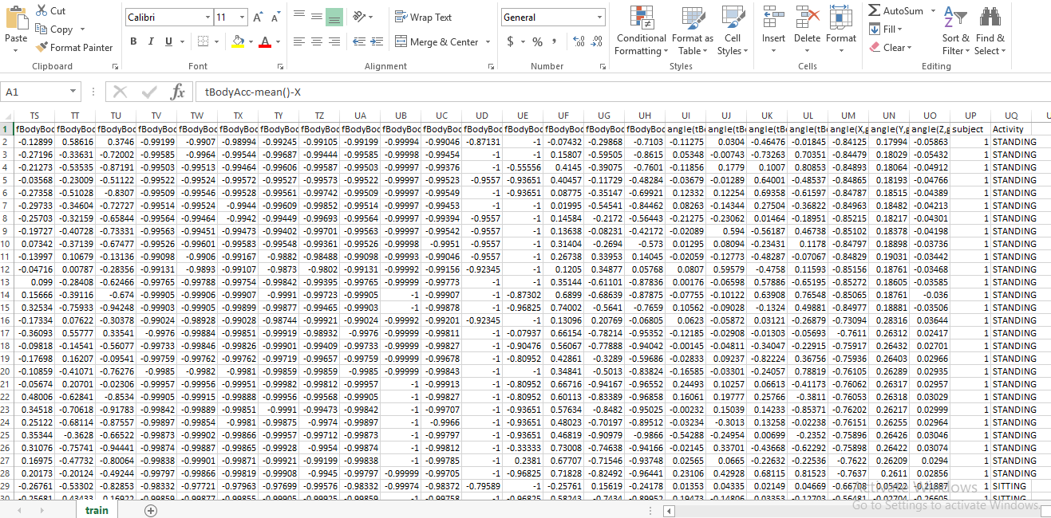
Existing Dataset:
Figure 3 : A portion of existing Dataset

Slide 13
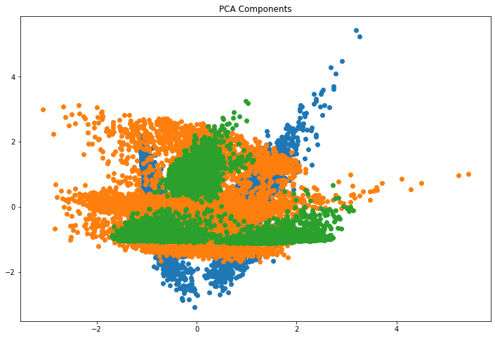
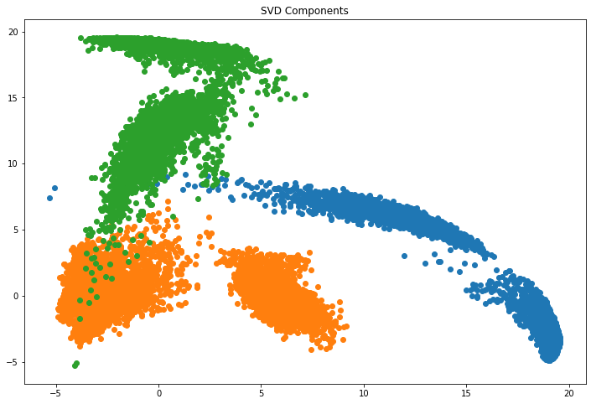
Existing Dataset:
II) Dimension Reduction Techniques:
Principle Component Analysis(PCA):
Singular Value Decomposition(SVD):
Figure 4 : Distribution of PCA components
Figure 5 : Distribution of SVD components

Slide 14
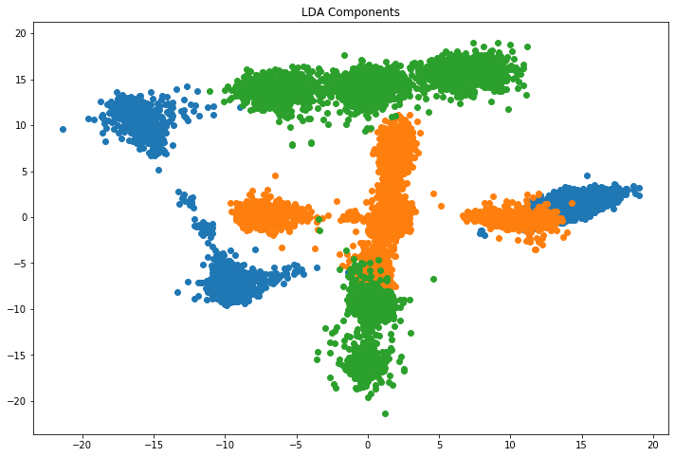
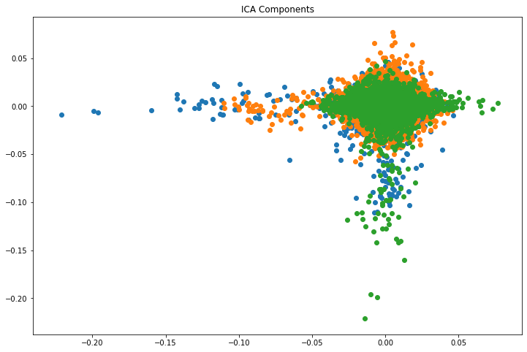
Existing Dataset:
II) Dimension Reduction Techniques:
Linear Discriminant Analysis(LDA):
Independent Component Analysis(ICA):
Figure 6 : Distribution of LDA components
Figure 7 : Distribution of ICA components

Slide 15
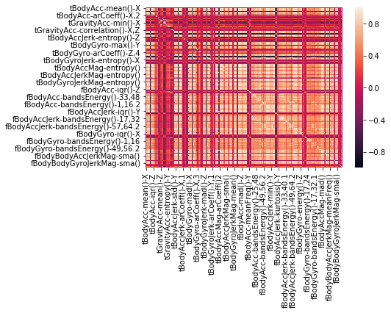
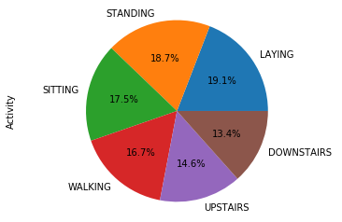
Existing Dataset:
III) Dataset Visualization:
Pie Chart:
Heatmap Plot:
Figure 8 : Pie chart of existing dataset
Figure 9 : Heatmap of existing dataset

Slide 16
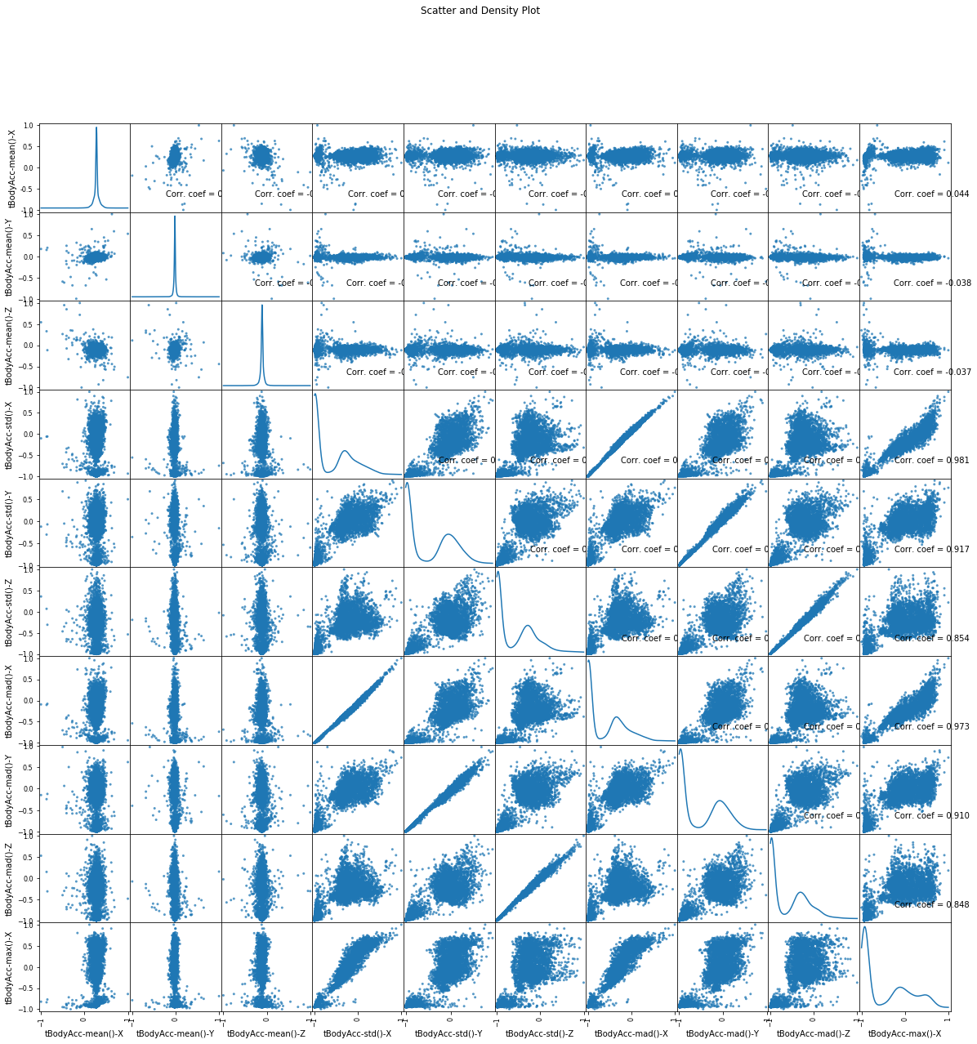
Existing Dataset:
III) Dataset Visualization:
Scatter and Density Plot
Figure 10 : Scatter and density plot of existing dataset

Slide 17
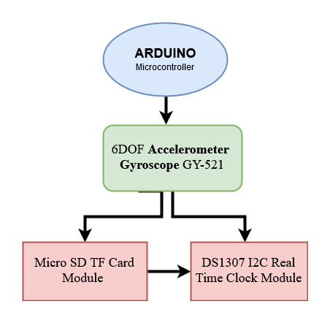
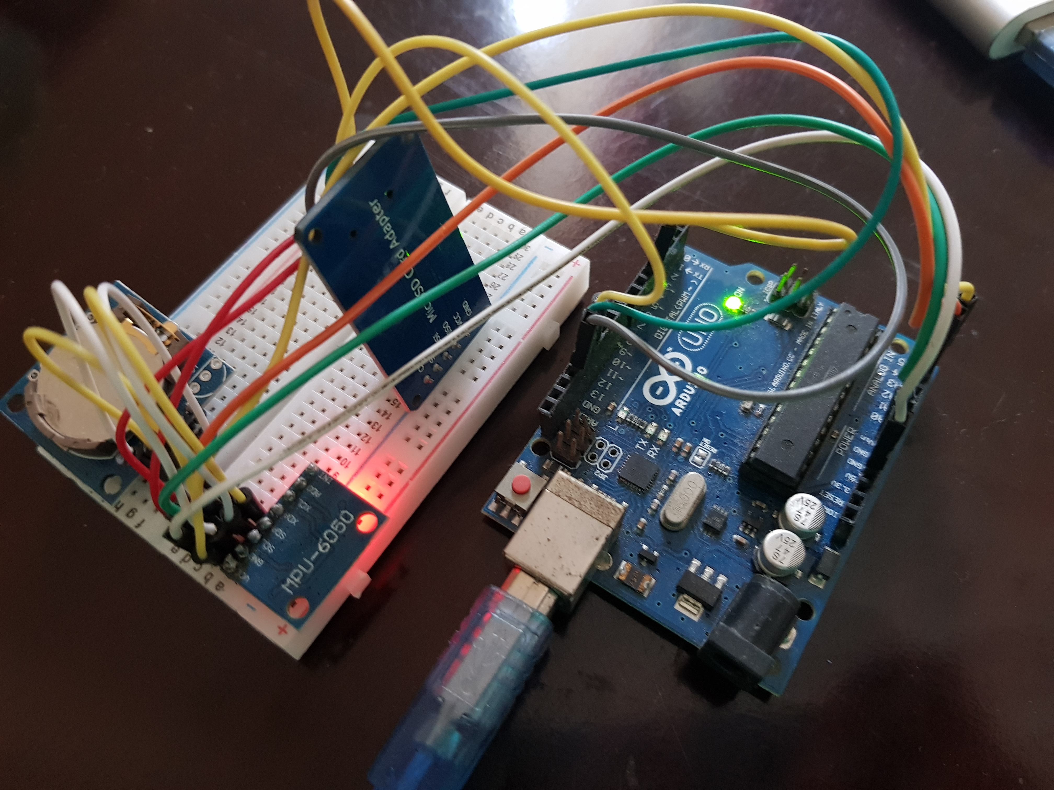
New Dataset:
I) Device Description
Figure 11 : Device setup for data collection

Slide 18
New Dataset:
II) Dataset Description
Collected data of six human activities e.g. laying, sitting, standing, walking, walking downstairs and walking upstairs
Targeted number of people were 30 aged between 55-65, 30-35 and 21-26 years
Chose homely environment and varsity area
CSV format has 2822 rows and 8 columns
Train set has 2257 rows and 6 columns and test set has 565 rows and 6 columns

Slide 19
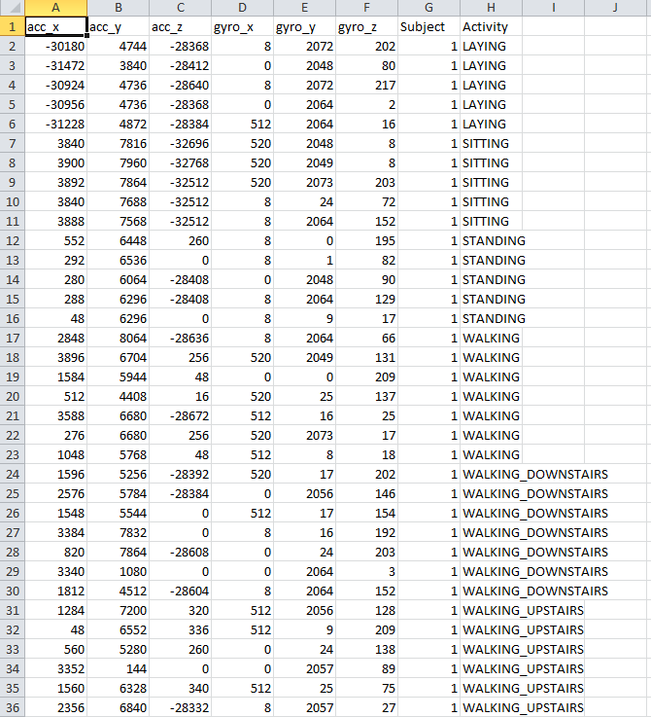
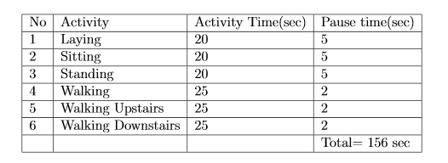
New Dataset:
TABLE I : Time of six activities of Human through Waist Mounted Device
Figure 12 : A portion of new Dataset

Slide 20
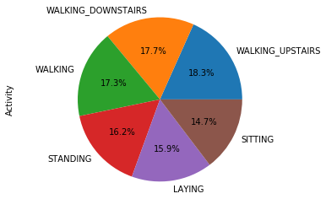
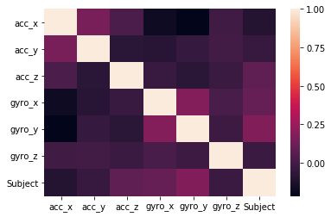
New Dataset:
III) Dataset Visualization:
Pie Chart:
Heatmap Plot:
Figure 13 : Pie chart of new dataset
Figure 14 : Heatmap of new dataset

Slide 21
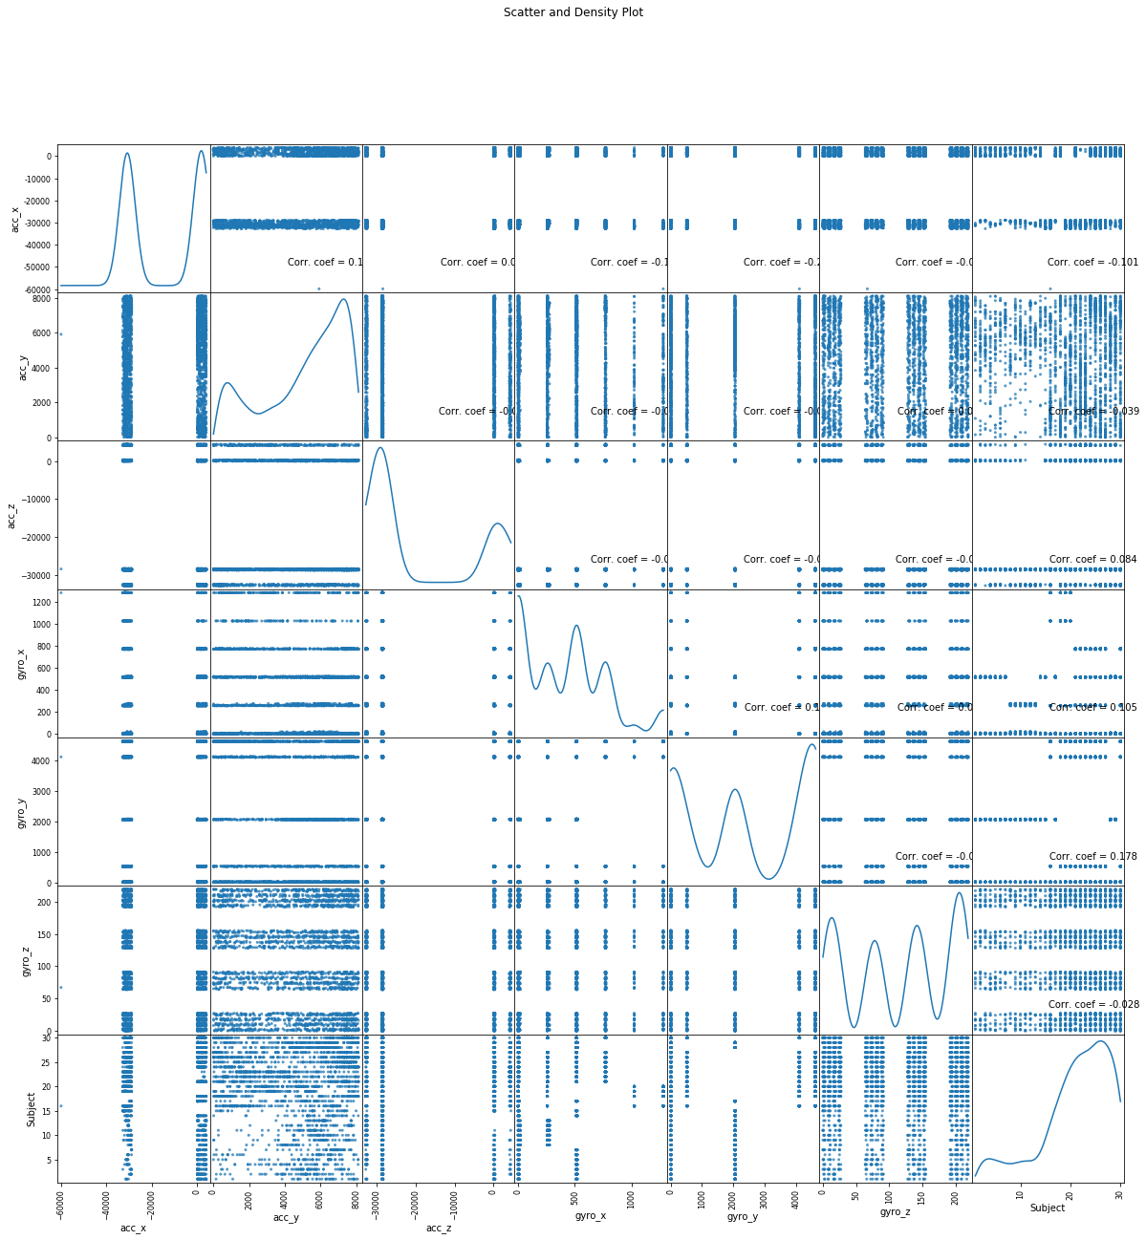
New Dataset:
III) Dataset Visualization:
Scatter and Density Plot
Figure 15 : Scatter and density plot of new dataset

Slide 22
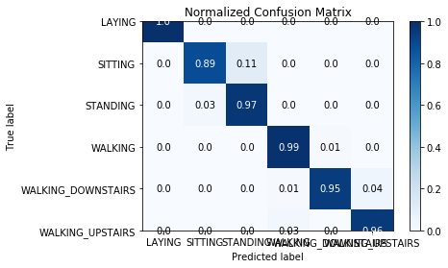
Methodology:
I)Support Vector Machine(SVM):
One of the best algorithms for classification and regression
Categorize multiple features by placing hyperplane among them
Application of cross validation through gridsearch technique to avoid overfitting
Accuracies for training and test data are 99.68% and 96.16% for 2947 occurrences of activities
Figure 16 : Confusion matrix of SVM

Slide 23
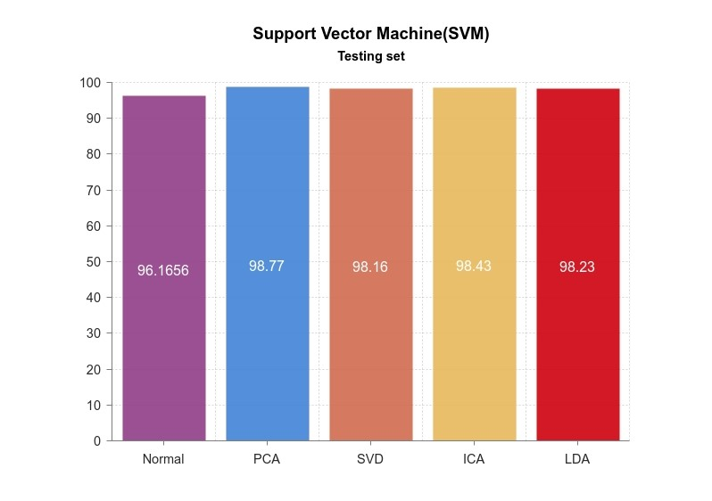
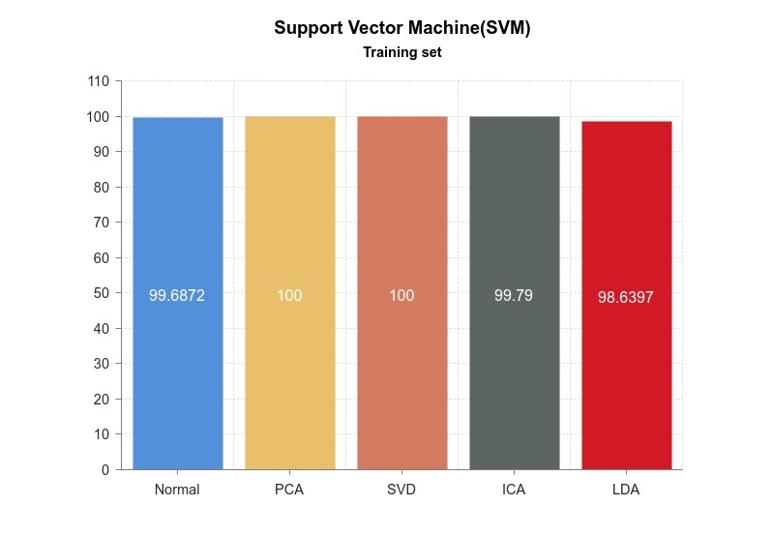
After applying reduction techniques,
In PCA, we got 99.28% and 97.55% accuracies for train and test data where number of components were 40. When we increased the components to 150 we obtained 100% and 98.77% accuracies for train and test data
In SVD, for 100 components we got 100% and 98.16% accuracy for train and test data respectively
In LDA, we got 98.64% accuracy for train data and 98.23% accuracy for test data while the number of components were 40
In ICA, we got 99.79% and 98.43% accuracy for train and test data for both cases of component numbers which are 20 and 150
Figure 17 : Training set result analysis graph of SVM
Figure 18 : Testing set result analysis graph of SVM

Slide 24
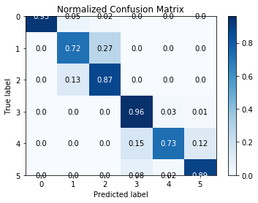
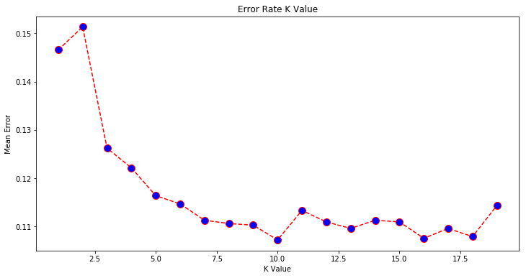
II) K-Nearest Neighbors (KNN):
Works well for classification problem like the existing dataset we have used to predict human activity
Value of Primary determination factor K indicates whether test set remains in which level of closeness to the train set
Obtained accuracy score is 86%
Regarding error rate of K value from the figure, we have the least error while the K value is 10 whereas we have the maximum error while the K value is 2.5 while number of components is 20
Figure 19 : Confusion matrix of KNN
Figure 20 : Error rate for K value

Slide 25
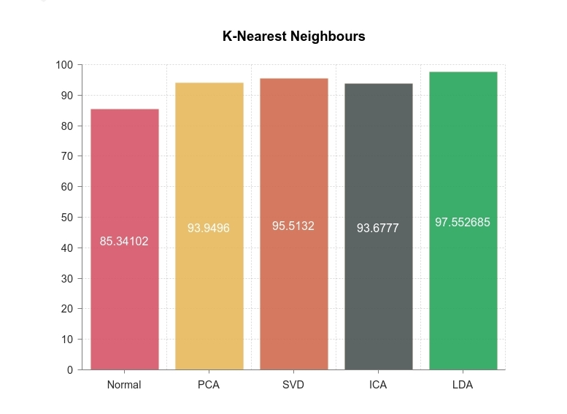
After applying reduction techniques,
In PCA, we got 93.95% accuracy for 40 components and 93.74% accuracy for 150 components
In SVD, we got 95.51% accuracy for 100 components
In LDA, we got 97.55% accuracy for 40 components
In ICA, we got 89.87% accuracy for 20 components and 93.67% accuracy for 150 Components
In all cases accuracy is observed for 1471 occurrences
Figure 21 : Result analysis graph of KNN

Slide 26
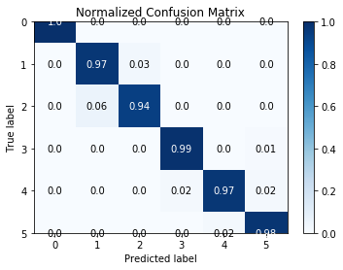
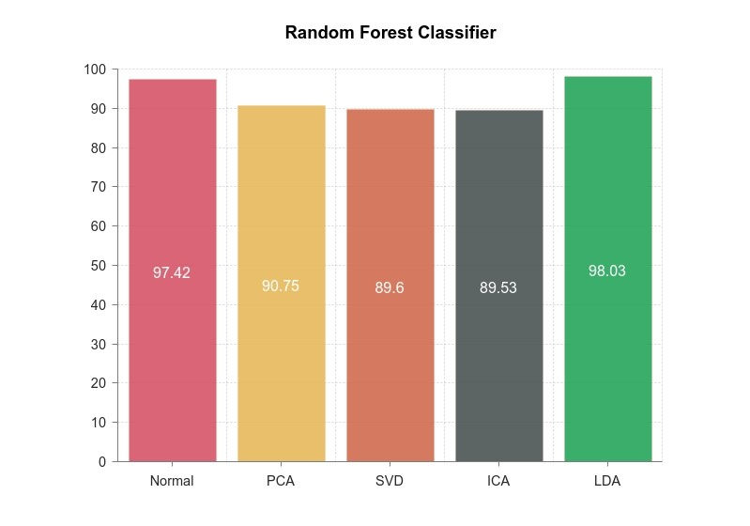
III) Random forest Classifier:
It works well on large dataset like the existing dataset due to dimension reduction feature
For forest creation null values are omitted
Classifying multiple features through random data selection
Obtained 97.42% accuracy by fitting the classifier
Figure 22 : Confusion matrix of random forest classifier
After applying reduction techniques,
In PCA obtained accuracy is 90.75% and 89.6% for 40 and 150 components respectively. In both cases the number of total occurrences of the activities is 1471
In SVD, accuracy is 89.6% for 100 components and 1471 occurrences of activities
In LDA, we got 98.03% accuracy for 40 components and 1471 occurrences of activities
In ICA, for 20 and 150 components we got 89.53% and 75.66% accuracies accordingly for 1471 occurrences of activities
Figure 23 : Result analysis graph of random forest classifier

Slide 27
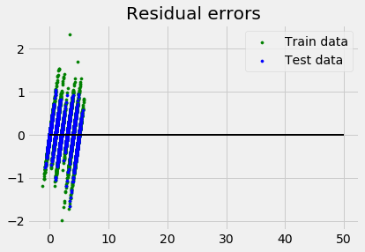
IV)Linear Regression:
Draws simple linear regression line between features of six activities (explanatory variables) and targeted activity (dependent variable)
The accuracy we have obtained is 98% for X test, Y test and 97% for X train, Y train.
Linearity of this model makes estimation and interpretation easier
In the residual error graph, distance of the points from the regression line determines the error
Figure 24 : Residual error for linear regression

Slide 28
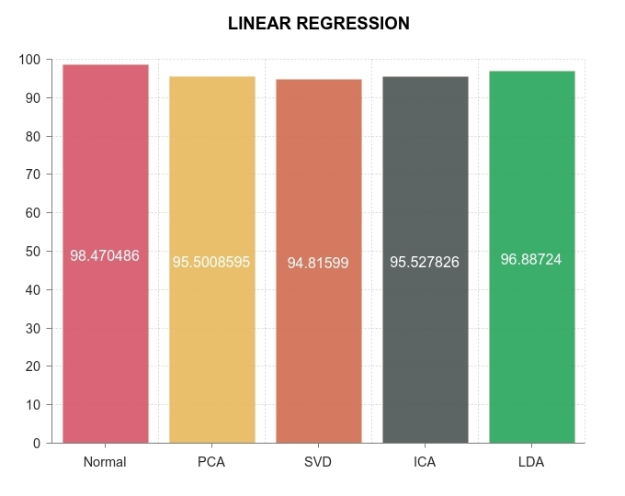
After applying reduction techniques,
In PCA obtained accuracy for both sets of variables is 92% ans 95% for 40 & 150 components
In SVD obtained accuracy for both sets of variables is 94% while the number of components were 100
In LDA the accuracy for X_train, Y_train is 97% and X_test, Y_test is 96.8% for 40 components
In ICA, we got 90% and 95% accuracy for both sets of variables regarding 20 & 150 components
Figure 25 : Result analysis graph of
Linear regression

Slide 29
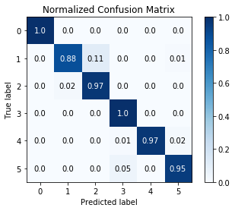
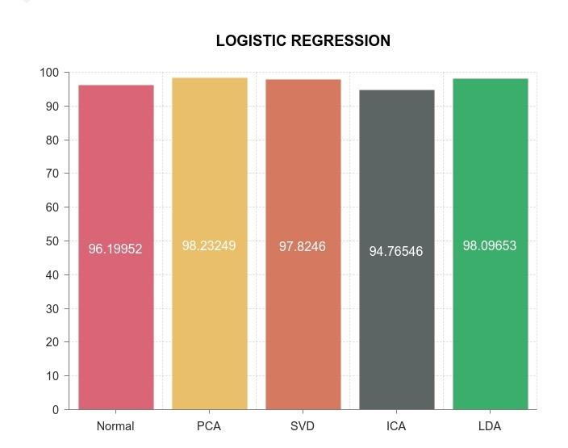
V) Logistic Regression:
Does predictive analysis of probability
Obtained accuracy is 96%
After applying reduction techniques,
In PCA obtained accuracy is 93% and 98% for 40 & 150 components
In SVD we got 97.82% accuracy for 100 components
In LDA accuracy is 98% for 40 components
In ICA our obtained accuracy is 83% and 94.76% for 20 & 150 components
Figure 26 : Confusion matrix of logistic regression
Figure 27 : Result analysis graph of logistic regression

Slide 30
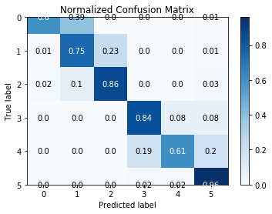
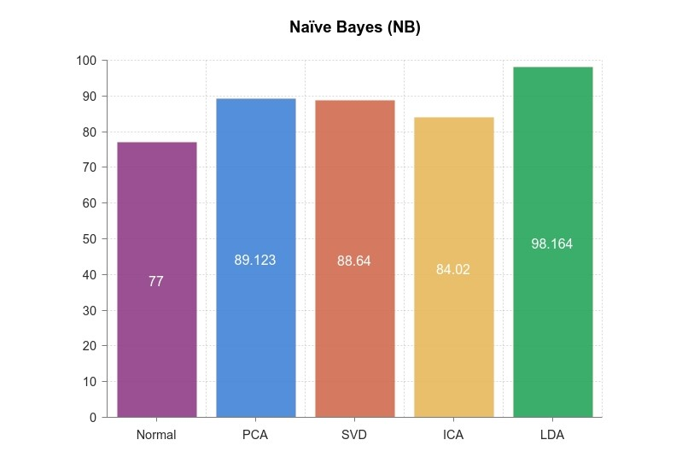
VI) Naive Bayes Classifier:
Supervised algorithm based on bayes theorem
We have used Gaussian Naive Bayes Classifier
It observes continuous values for each feature and thus distributes them to belongings
Here X_train set has the input independent variables and Y_train set has the numerical values from 0 to 5 for six activities.
Accuracy of naive bayes classifier is 77.0274% for 2947 occurrences
Figure 28 : Confusion matrix of naïve bayes
After applying reduction techniques,
In PCA, we got 89.12% accuracy for 40 components and 86.33% accuracy for 150 components
In SVD, for 100 components we got 88.64% accuracy
In LDA, for 40 components we got 98.16% accuracy
In ICA we got 84.02% accuracy for 20 components and 81.91% accuracy for 150 components
Figure 29 : Result analysis graph of naïve bayes

Slide 31
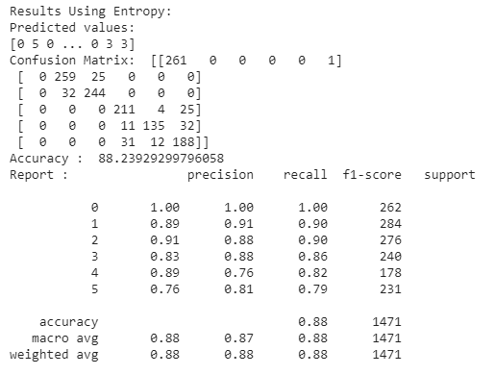
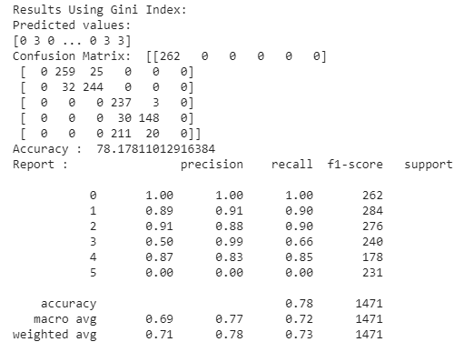
VII) Decision Tree:
Used to identify and regress supervised learning
It’s splitting criteria determines best split among all split points
Recursive division occurs until there is only one sample in the leaves
Gini impurity is used to calculate the uncertainty as the dividing criterion
Entropy Function and Information Gain are used as metrics to implement classier function by ID3 (Iterative Dichotomiser 3)
Got 78.18% accuracy using Gini index and 88.24% accuracy using Entropy
Figure 30 :confusion matrix of entropy
Figure 31 : Confusion matrix of gini index

Slide 32
VIII) : Multilayer perceptron (MLP)
One directional data transmission across multiple interconnected neuron layers
Intermediate layers may exist between input and output layer
Rectifier linear unit (ReLU) is the most common activation function of a neural network's hidden layers
Softmax being a type of sigmoid function is really useful for multi-class dataset classification like ours existing dataset
Obtained 98.57% accuracy in the output layer along with the prediction of the designated activity

Slide 33
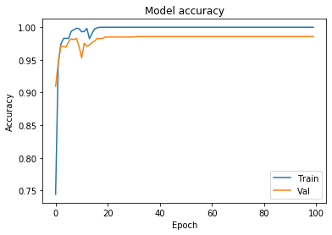

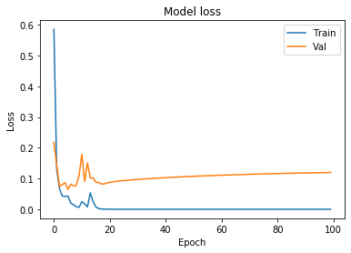
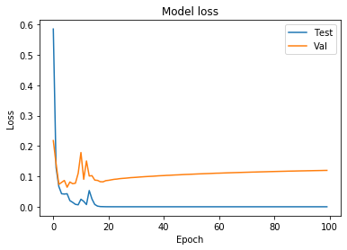
Regarding loss function graph for test and train datasets we have the following results:,
In PCA, we got 98.70% accuracy for 150 components. Visualization of loss function result for PCA has straight lines for both train and test value. Its because of the reduction technique of PCA which changes the interdependencies between data parameters and gives less error than modeling of original dataset.
In SVD, we have 98.64% accuracy for 100 components. Here, Loss function graph also gives straight lines for both train and value like PCA as its also have interdependency moderation mechanism for reduction formula.
Figure 32 : Model accuracy for train and test
Figure 33 : Model loss for train and test

Slide 34
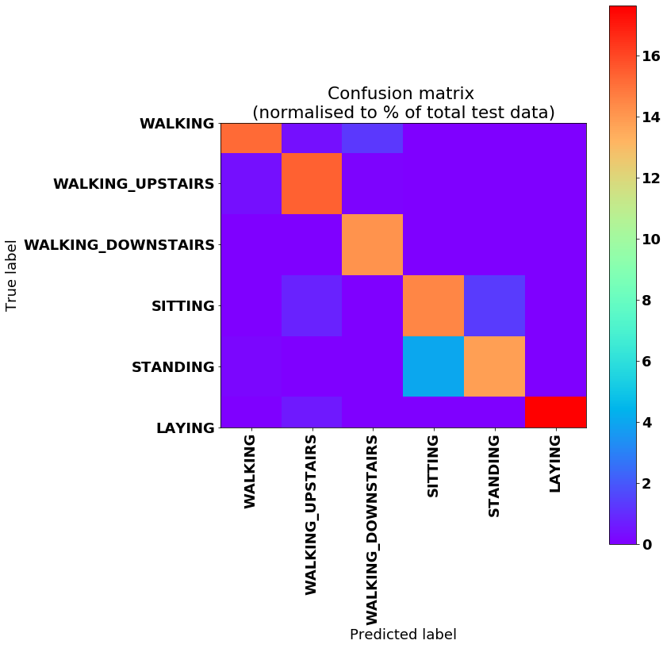
IX) : Long short-term memory (LSTM)
Quite good in accurate movement identification of humans
These predictions are extremely accurate considering the raw data
Obtained accuracy is 90.70%
Figure 34 : Confusion matrix of LSTM

Slide 35
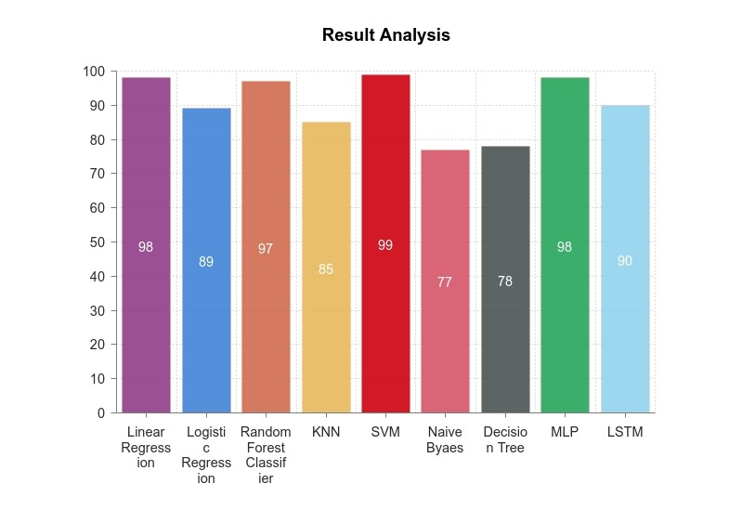
Result Analysis:
Best fit algorithm is SVM for the existing dataset without and with application of reduction techniques
Figure 35 : Result analysis graph for all classifier

Slide 36
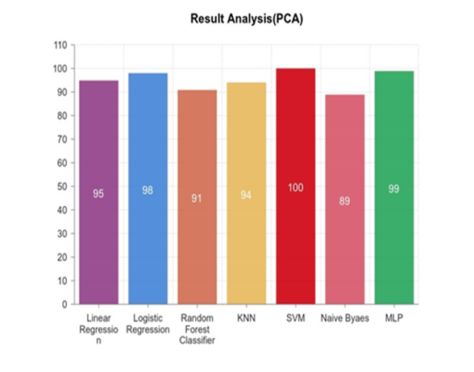
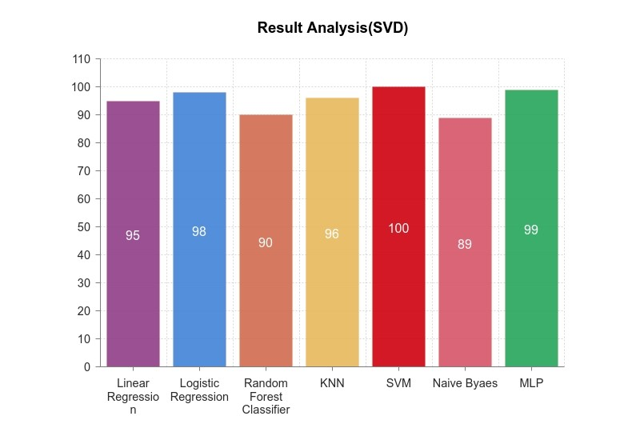
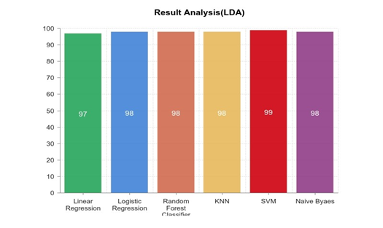
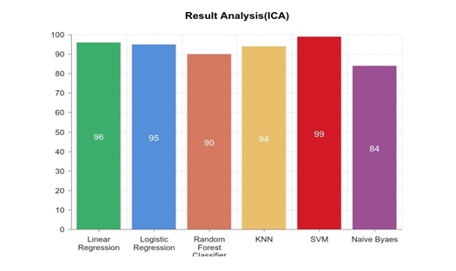
Figure 36 : Result analysis graph for all classifier using PCA
Figure 37 : Result analysis graph for all classifier using SVD
Figure 38 : Result analysis graph for all classifier using LDA
Figure 39 : Result analysis graph for all classifier using ICA

Slide 37
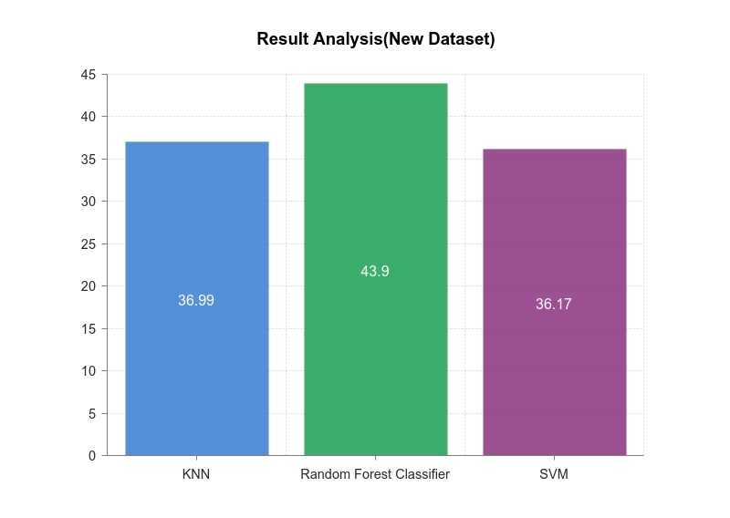
Result Analysis:
Best fit algorithm is Random Forest Classifier for the new dataset
Figure 40 : Result analysis graph of new dataset

Slide 38
Conclusion & Future Works:
Limitations:
Size of new dataset
Number of features
To observe elderly persons’ activities
Target old age home for data collection
Developing our device using more sensors
Build a wearable wristband to monitor old persons’ activities real time basis
Extending size of dataset
Extraction of more features
Modeling data using machine learning classifiers and predicting activities
Developing a health monitoring system

Slide 39
References:
T. Iso and K. Yamazaki, “Gait analyzer based on a cell phone with a single three-axis accelerometer”, in Proceedings of the 8th conference on Human-computer interaction with mobile devices and services, ACM, 2006, pp. 141–144.
T. Saponas, J. Lester, J. Froehlich, J. Fogarty, and J. Landay, “Ilearn on the iphone: Real-time human activity classification on commodity mobile phones”,University of Washington CSE Tech Report UW-CSE-08-04-02, vol. 2008,2008.
H. Lu, J. Yang, Z. Liu, N. D. Lane, T. Choudhury, and A. T. Campbell, “The jigsaw continuous sensing engine for mobile phone applications”, in Proceedings of the 8th ACM conference on embedded networked sensor systems, ACM, 2010,pp. 71–84.
S. Dernbach, B. Das, N. C. Krishnan, B. L. Thomas, and D. J. Cook, “Simple and complex activity recognition through smart phones”, in 2012 Eighth International Conference on Intelligent Environments, IEEE, 2012, pp. 214-221.
J. Guiry, P. Van de Ven, and J. Nelson, “Multi-sensor fusion for enhanced contextual awareness of everyday activities with ubiquitous devices”,Sensors,vol. 14, no. 3, pp. 5687–5701, 2014.
J. Wang, Y. Chen, S. Hao, X. Peng, and L. Hu, “Deep activity recognition models with triaxial accelerometers”,Proceedings of the Computer Vision and Pattern Recognition, Honolulu, HI, USA, pp. 21–26, 2017.
M. Shoaib, S. Bosch, O. Incel, H. Scholten, and P. Havinga, “Fusion of smartphone motion sensors for physical activity recognition”, Sensors, vol. 14, no. 6,pp. 10 146–10 176, 2014.
Anguita, D., Ghio, A., Oneto, L., Parra, X., & Reyes-Ortiz, J. L. (2013, April). A public domain dataset for human activity recognition using smartphones. In Esann.”
Cheng, L., Guan, Y., Zhu, K., & Li, Y. (2017, January). Recognition of human activities using machine learning methods with wearable sensors. In 2017 IEEE 7th annual computing and communication workshop and conference (CCWC) (pp. 1-7). IEEE.
Ravi, N., Dandekar, N., Mysore, P., & Littman, M. L. (2005, July). Activity recognition from accelerometer data. In Aaai(Vol. 5, No. 2005, pp. 1541-1546)
”Tran, D. N., & Phan, D. D. (2016, January). Human activities recognition in android smartphone using support vector machine. In 2016 7th International Conference on Intelligent Systems, Modelling and Simulation (ISMS) (pp. 64-68). IEEE.”

Slide 40
Response of Comments on the Submitted Thesis Report:
Modified the motivation
Represented introduction and thesis statement points in multiple paragraphs

Slide 41
THANK YOU

Slide 42
???
Questions
???

